Slide 1



DATAWIZE
DATAWIZE
The ultimate solution for project improvements

Slide 2
DATAWIZE
Index
THE TEAM
THE PROBLEM: INCONSISTENT DATA
THE SOLUTION: STANDARDIZE DATA
THE MARKET: IMPACT AND POTENTIAL
THE COMPETITION: DIFFERENTIATORS
THE FUTURE: ROADMAP AND NEXT STEPS

Slide 3
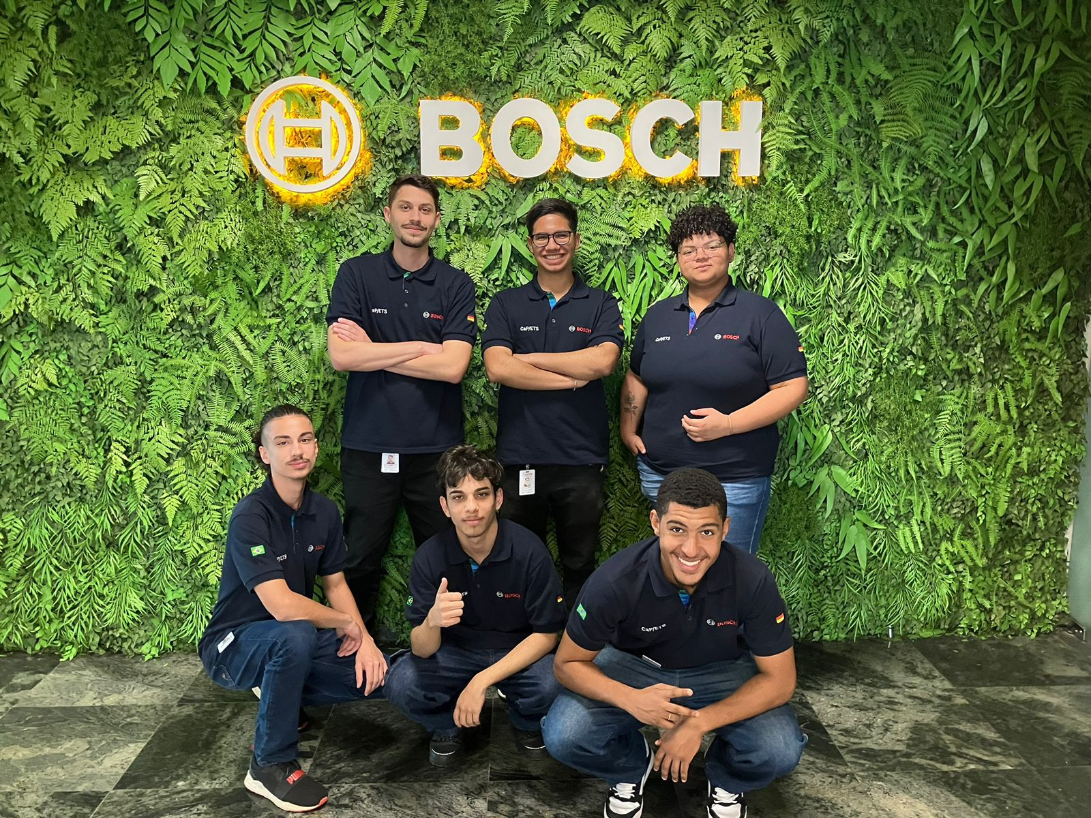
DATAWIZE
THE TEAM:

Slide 4




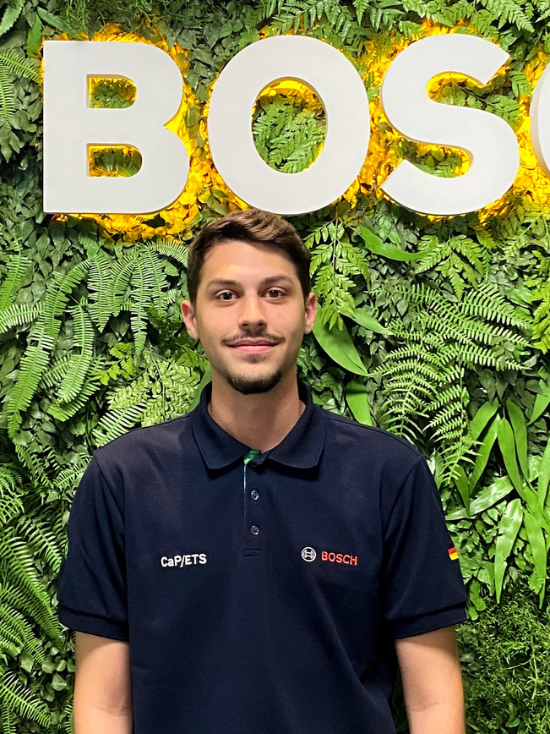
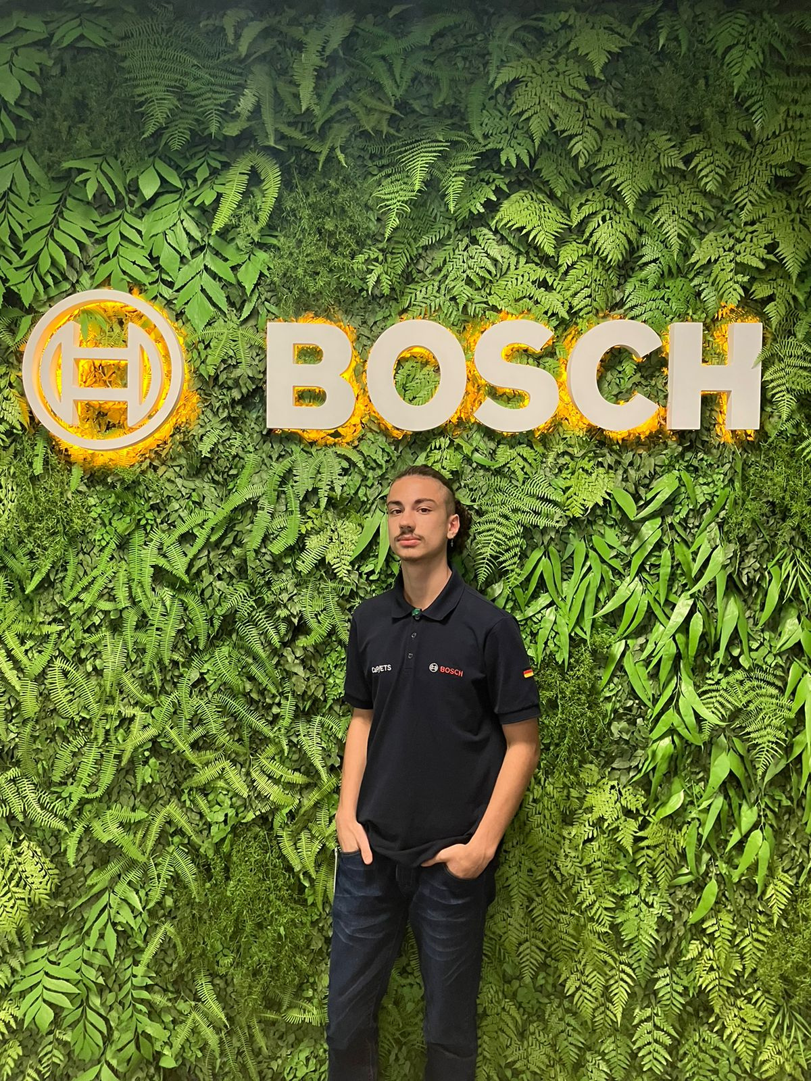
DATAWIZE
THE TEAM:
ÂNGELO CARNEVALE
BYANKA MONTEIRO
DIEGO JACOBER
FRONT-END
FRONT-END
FULLSTACK
GUSTAVO ANACLETO
LUÍS BECK
RAPHAEL PRATES
FULLSTACK
DESIGN / BACK-END
BACK-END

Slide 5


Slide 6


DATAWIZE
THE PROBLEM:
Inconsistent Data
CASE X
CASE Y
IMPROVEMENT
IMPROVEMENT
CURRENT * ORGANIZATION
GS/PUI-LA
CURRENT * ORGANIZATION
KT/BC-ZZ
CREATE
CREATE
DEPARTAMENT *
GS/OIS-LA1
DEPARTAMENT *
-
SUMMARY *
PROBLEM SUMMARY
SUMMARY *
@FEV7CA
-
MAJOR*
BENEFITS
COST REDUCTION
SCHMIED*
COST REDUCTION

Slide 7




DATAWIZE
“If you define the problem correctly, you almost have the solution.”
–​ Steve Jobs

Slide 8




DATAWIZE
THE SOLUTION:
Standardize data
STANDARD IMPROVEMENT
HTTPS://DATAWIZE.BOSCH.COM
CURRENT * ORGANIZATION
GS/PUI-LA
VERIFY
DEPARTAMENT *
GS/OIS-LA1
SUMMARY *
PROBLEM SUMMARY
MAJOR*
BENEFITS
COST REDUCTION

Slide 9
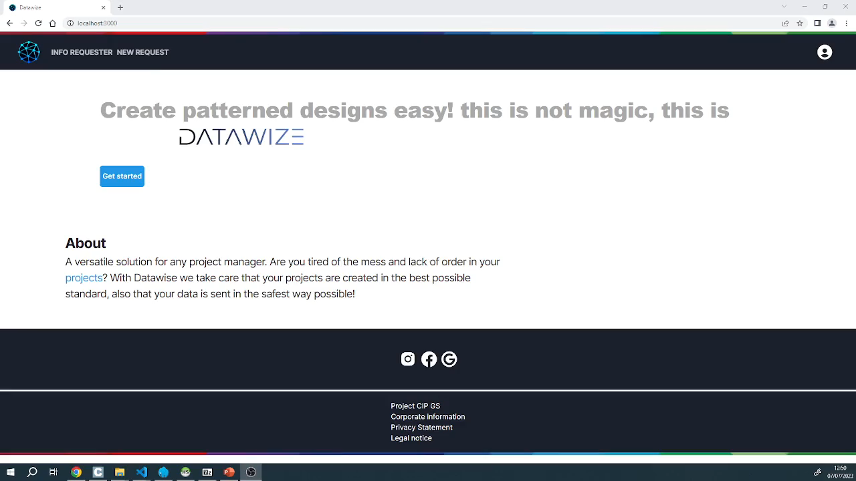
DATAWIZE
THE SOLUTION:

Slide 10






DATAWIZE
THE SOLUTION:
Tools

Slide 11


DATAWIZE
THE MARKET:
Impact
480 hours
120 hours
/year
/year
around R$38.000,00 for the creation and maintenance of the issues
around R$9.500,00 just for the creation of the issues
75% savings

Slide 12




DATAWIZE
THE MARKET:
Potential

Slide 13

DATAWIZE
THE COMPETITION:
Differentiators

Slide 14





DATAWIZE
THE FUTURE:
Next steps

Slide 15




DATAWIZE
Do you have any doubts?
DATAWIZE
@datawize
Contact us!
github.com/datawize-ets
ETS
@ets
ct67ca@br.bosch.com

Slide 16
DATAWIZE

